Slide 1
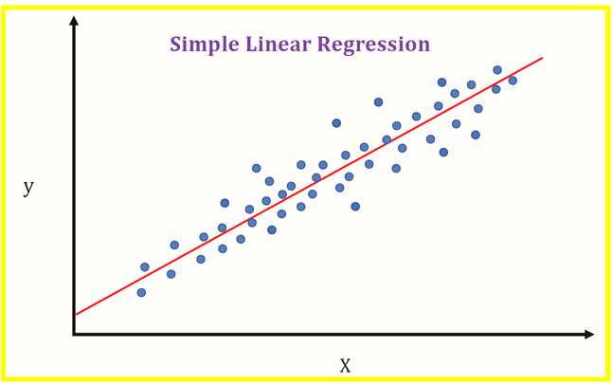
Linear Regression
What is Regression
Regression is a form of predictive analysis that examines the relationship between one or more independent variables to a dependent variable. It’s basically like functions: some value of x is inputted, that value is manipulated through certain coefficients like a slope or intercept, and finally another value is outputted.
Linear regression is a technique that is used when the shape of the dataset best resembles a straight line
There are several use cases for linear regression. For instance, it can be used to predict the sales of a product, pricing, performance, or the salaries of prospected employees.

Slide 2
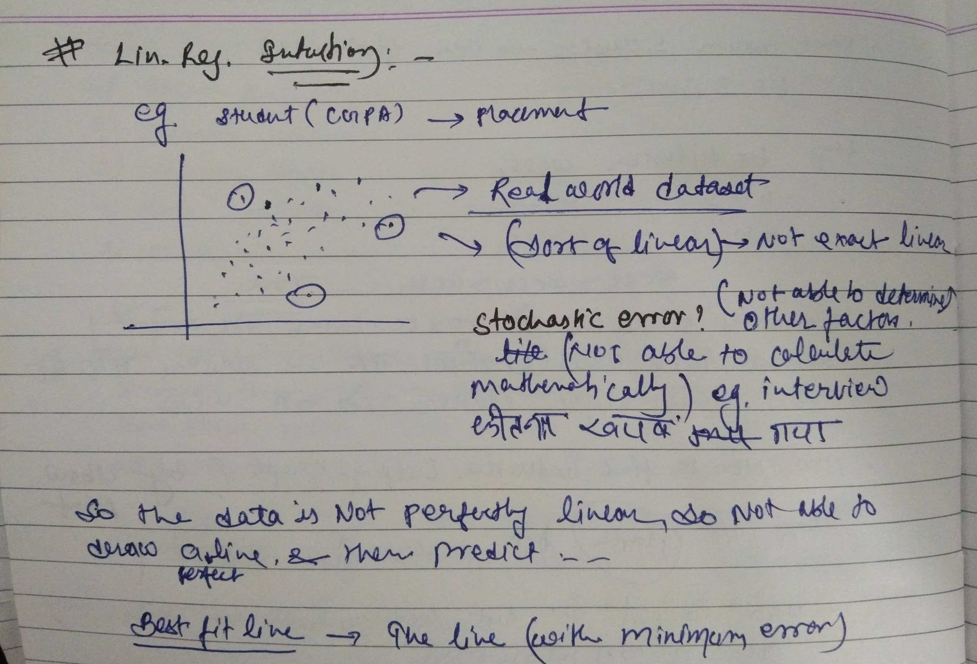
Linear Regression

Slide 3
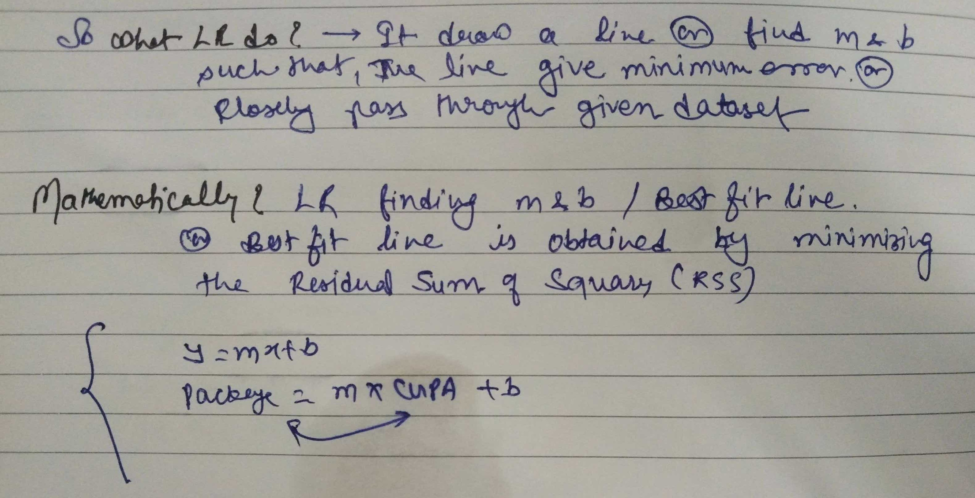
Linear Regression

Slide 4
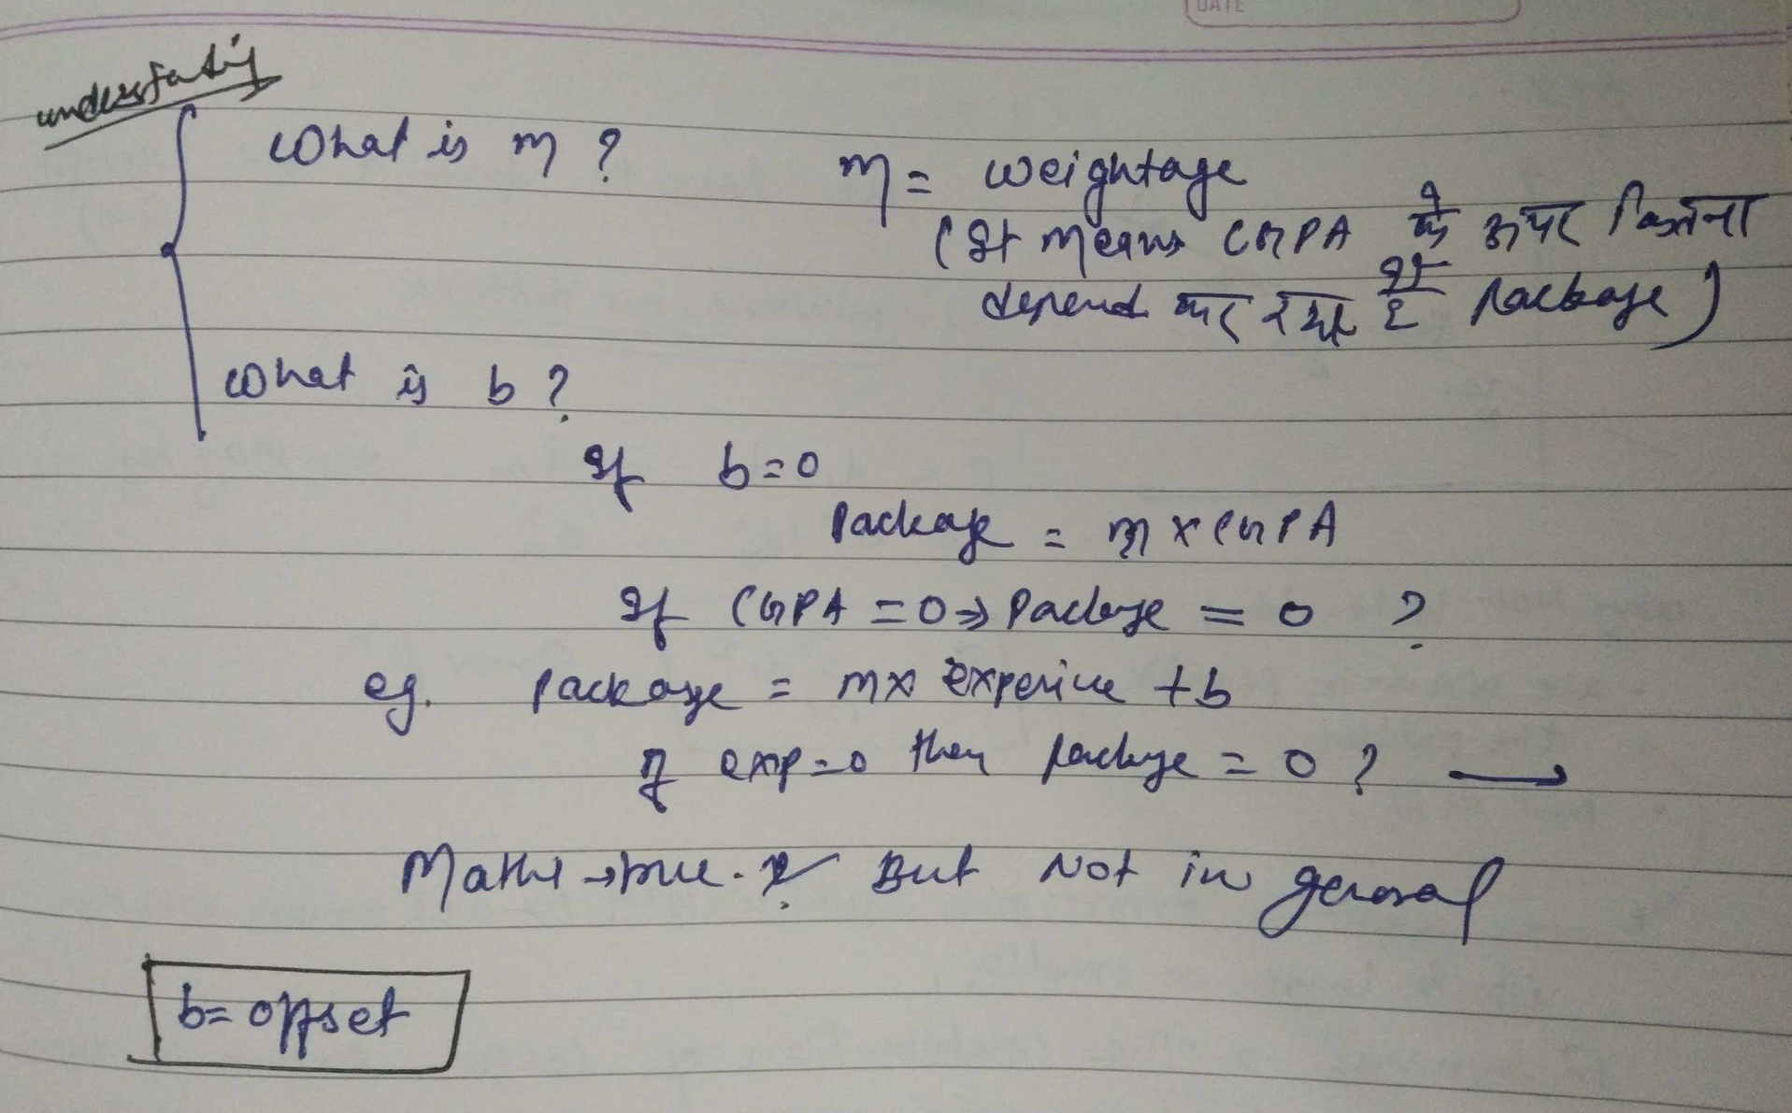
Linear Regression

Slide 5
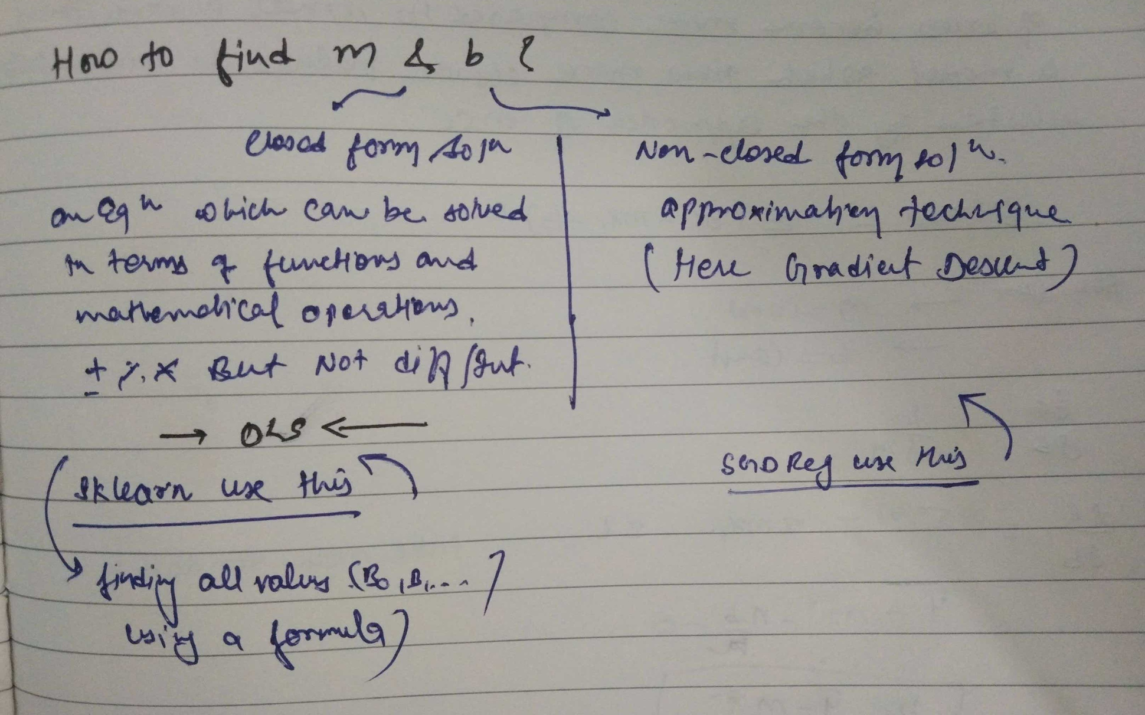
Linear Regression

Slide 6
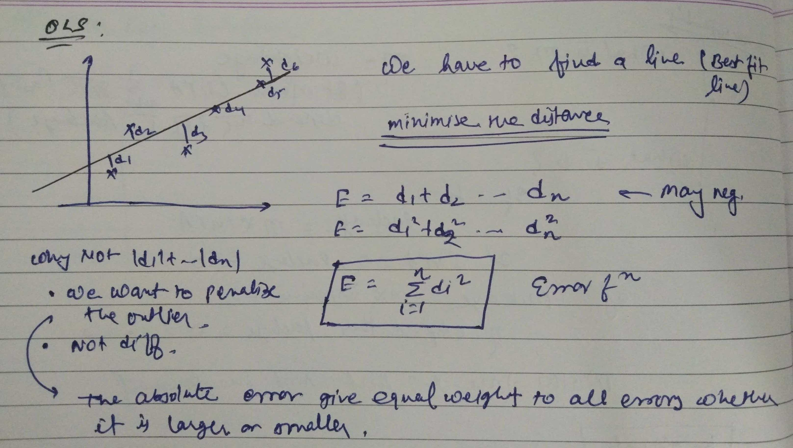
OLS MODEL (Ordinary Least Squares )

Slide 7
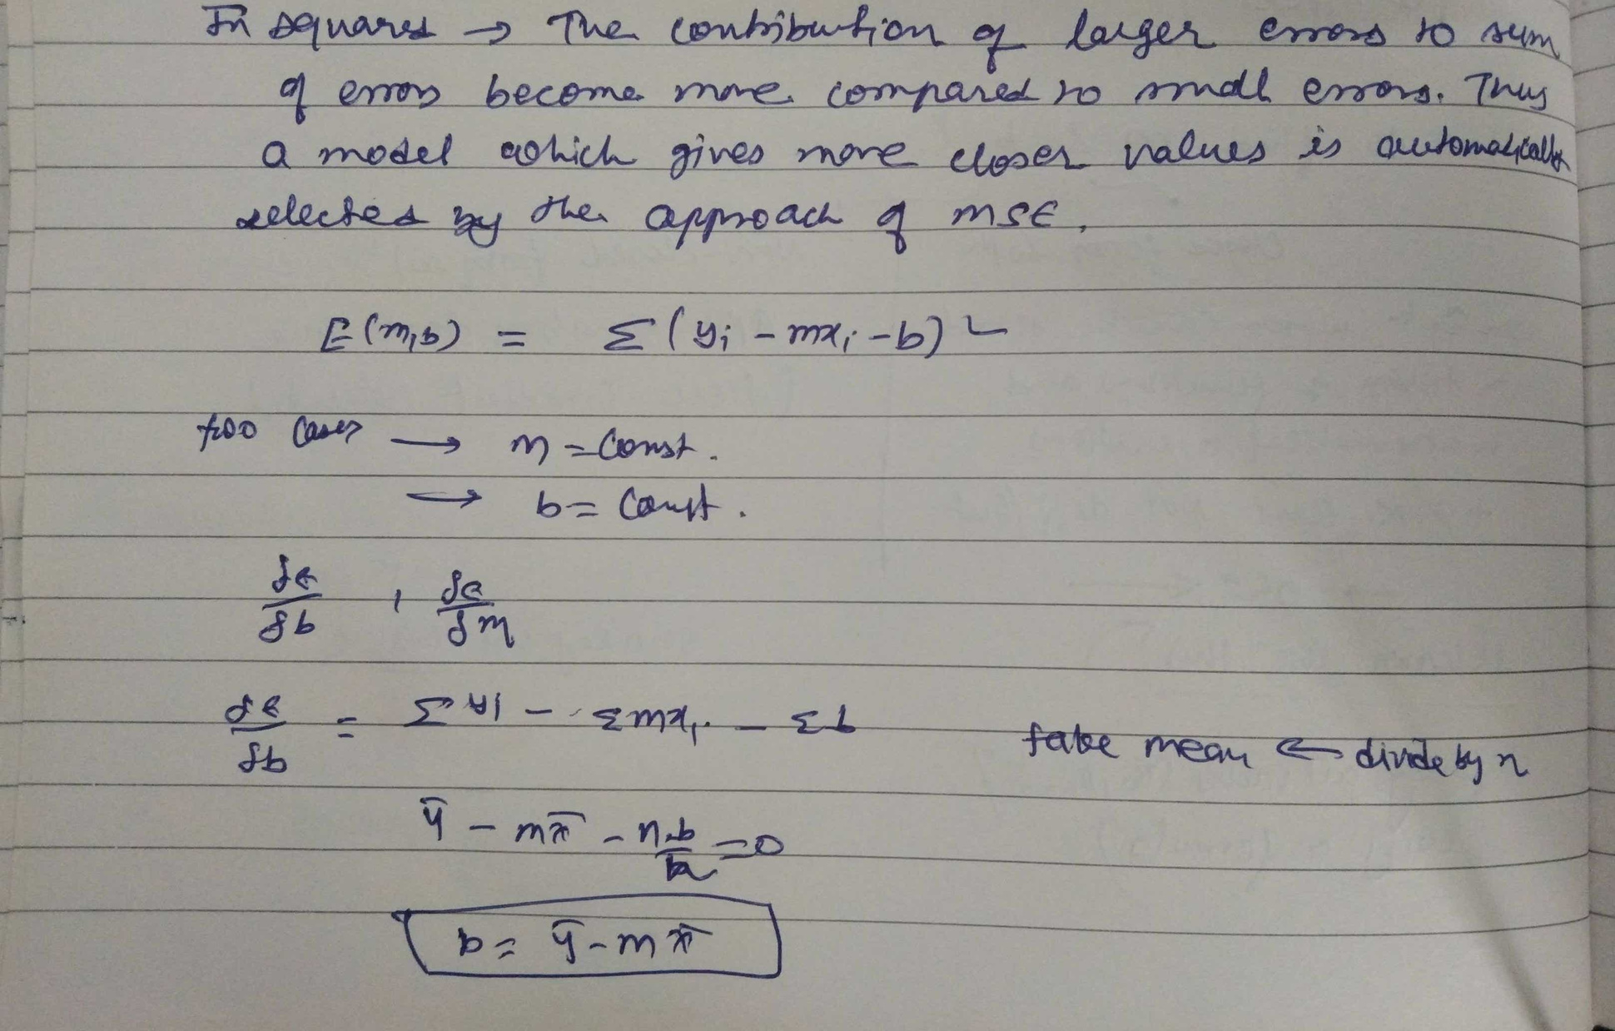
OLS MODEL (Ordinary Least Squares )

Slide 8
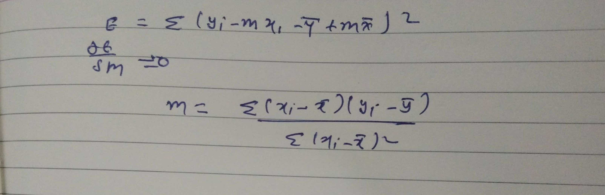
OLS MODEL (Ordinary Least Squares )

Slide 9
Why We require Evaluation Metrics?
Most beginners and practitioners most of the time do not bother about the model performance. The talk is about building a well-generalized model, Machine learning model cannot have 100 per cent efficiency otherwise the model is known as a biased model. which further includes the concept of overfitting and underfitting.
It is necessary to obtain the accuracy on training data, But it is also important to get a genuine and approximate result on unseen data otherwise Model is of no use.
So to build and deploy a generalized model we require to Evaluate the model on different metrics which helps us to better optimize the performance, fine-tune it, and obtain a better result.
If one metric is perfect, there is no need for multiple metrics. To understand the benefits and disadvantages of Evaluation metrics because different evaluation metric fits on a different set of a dataset.

Slide 10
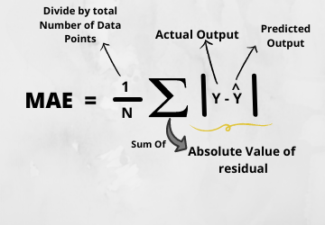
1) Mean Absolute Error(MAE)
Advantages of MAE
The MAE you get is in the same unit as the output variable.
It is most Robust to outliers.
Disadvantages of MAE
The graph of MAE is not differentiable so we have to apply various optimizers like Gradient descent which can be differentiable.

Slide 11
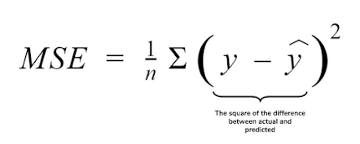
2) Mean Squared Error(MSE)
Advantages of MSE
The graph of MSE is differentiable, so you can easily use it as a loss function.
Disadvantages of MSE
The value you get after calculating MSE is a squared unit of output. for example, the output variable is in meter(m) then after calculating MSE the output we get is in meter squared.
If you have outliers in the dataset then it penalizes the outliers most and the calculated MSE is bigger. So, in short, It is not Robust to outliers which were an advantage in MAE.

Slide 12
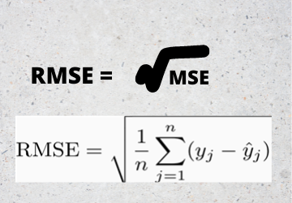
3) Root Mean Squared Error(RMSE)
Advantages of RMSE
The output value you get is in the same unit as the required output variable which makes interpretation of loss easy.
Disadvantages of RMSE
It is not that robust to outliers as compared to MAE.
for performing RMSE we have to NumPy NumPy square root function over MSE.

Slide 13
4) R Squared (R2)
R2 score is a metric that tells the performance of your model, not the loss in an absolute sense that how many wells did your model perform.
In contrast, MAE and MSE depend on the context as we have seen whereas the R2 score is independent of context.
So, with help of R squared we have a baseline model to compare a model which none of the other metrics provides. The same we have in classification problems which we call a threshold which is fixed at 0.5. So basically R2 squared calculates how must regression line is better than a mean line.
Hence, R2 squared is also known as Coefficient of Determination or sometimes also known as Goodness of fit.

Slide 14
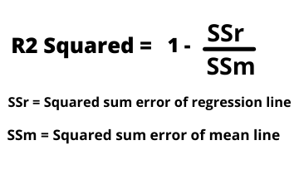
4) R Squared (R2)
Linear Reg wala line , mean wale line se kitna better hai
1)Now, how will you interpret the R2 score? suppose If the R2 score is zero then the above regression line by mean line is equal means 1 so 1-1 is zero. So, in this case, both lines are overlapping means model performance is worst, It is not capable to take advantage of the output column.
2)R2 score can be negative
3)Now the second case is when the R2 score is 1, it means when the division term is zero and it will happen when the regression line does not make any mistake, it is perfect. In the real world, it is not possible.
So we can conclude that as our regression line moves towards perfection, R2 score move towards one. And the model performance improves.
The normal case is when the R2 score is between zero and one like 0.8 which means your model is capable to explain 80 per cent of the variance of data.
Jitna jyada r2 better ,utna better model

Slide 15
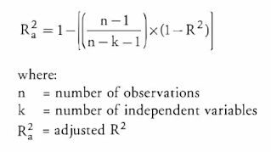
5) Adjusted R Squared
The disadvantage of the R2 score is while adding new features in data the R2 score starts increasing or remains constant but it never decreases because It assumes that while adding more data variance of data increases.
But the problem is when we add an irrelevant feature in the dataset then at that time R2 sometimes starts increasing which is incorrect.
Hence, To control this situation Adjusted R Squared came into existence.
Now as K increases by adding some features so the denominator will decrease, n-1 will remain constant. R2 score will remain constant or will increase slightly so the complete answer will increase and when we subtract this from one then the resultant score will decrease. so this is the case when we add an irrelevant feature in the dataset.
And if we add a relevant feature then the R2 score will increase and 1-R2 will decrease heavily and the denominator will also decrease so the complete term decreases, and on subtracting from one the score increases.

Slide 16
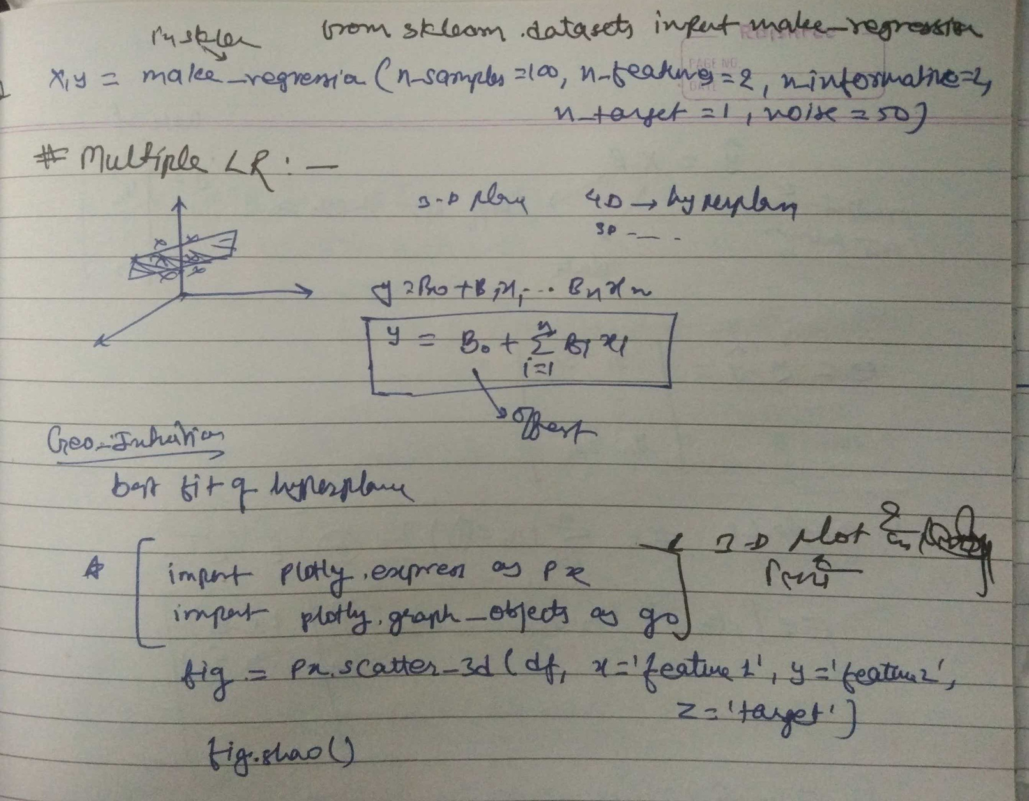
Multiple LR

Slide 17
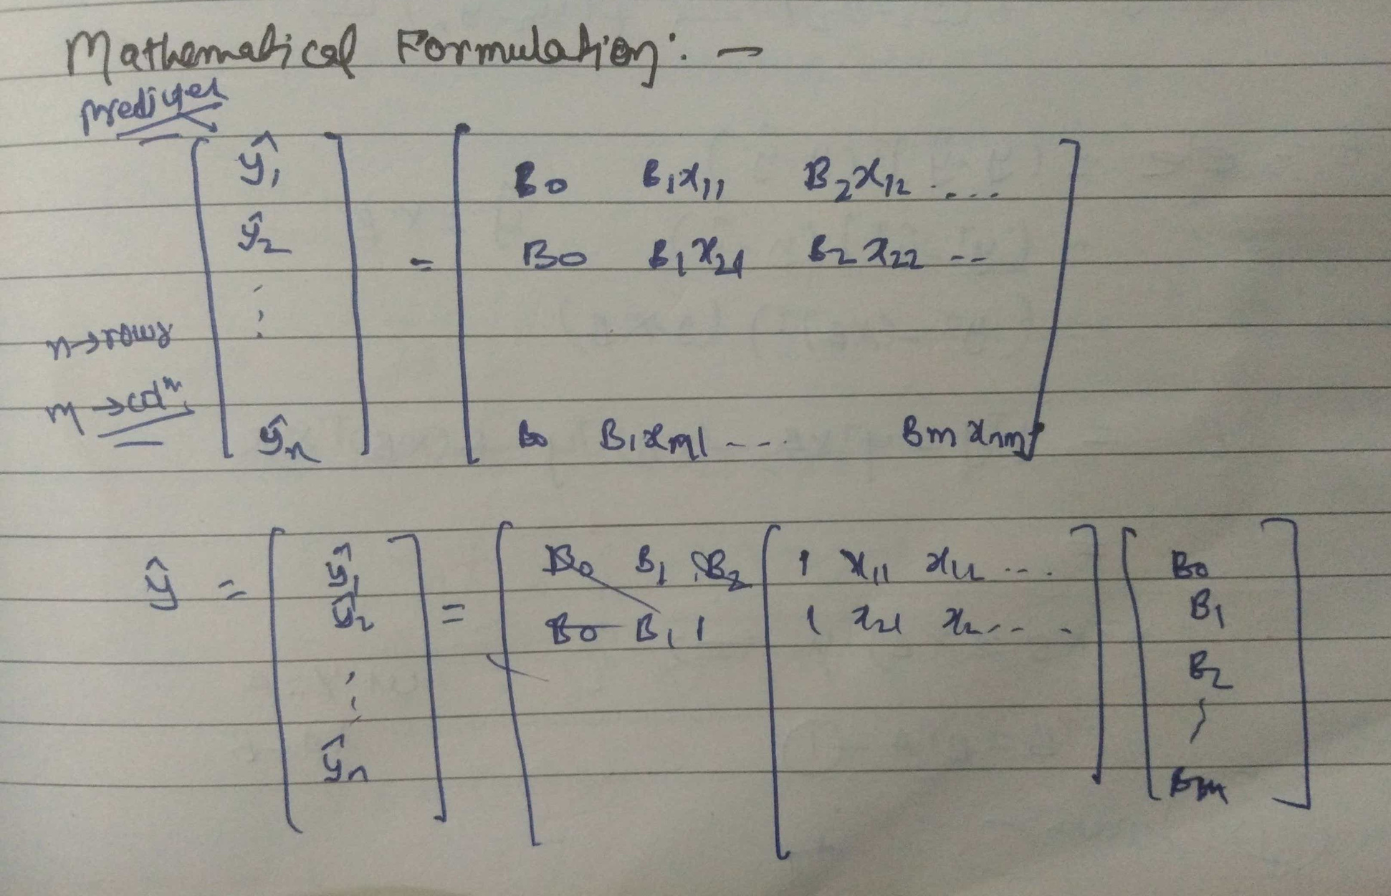
Multiple LR

Slide 18
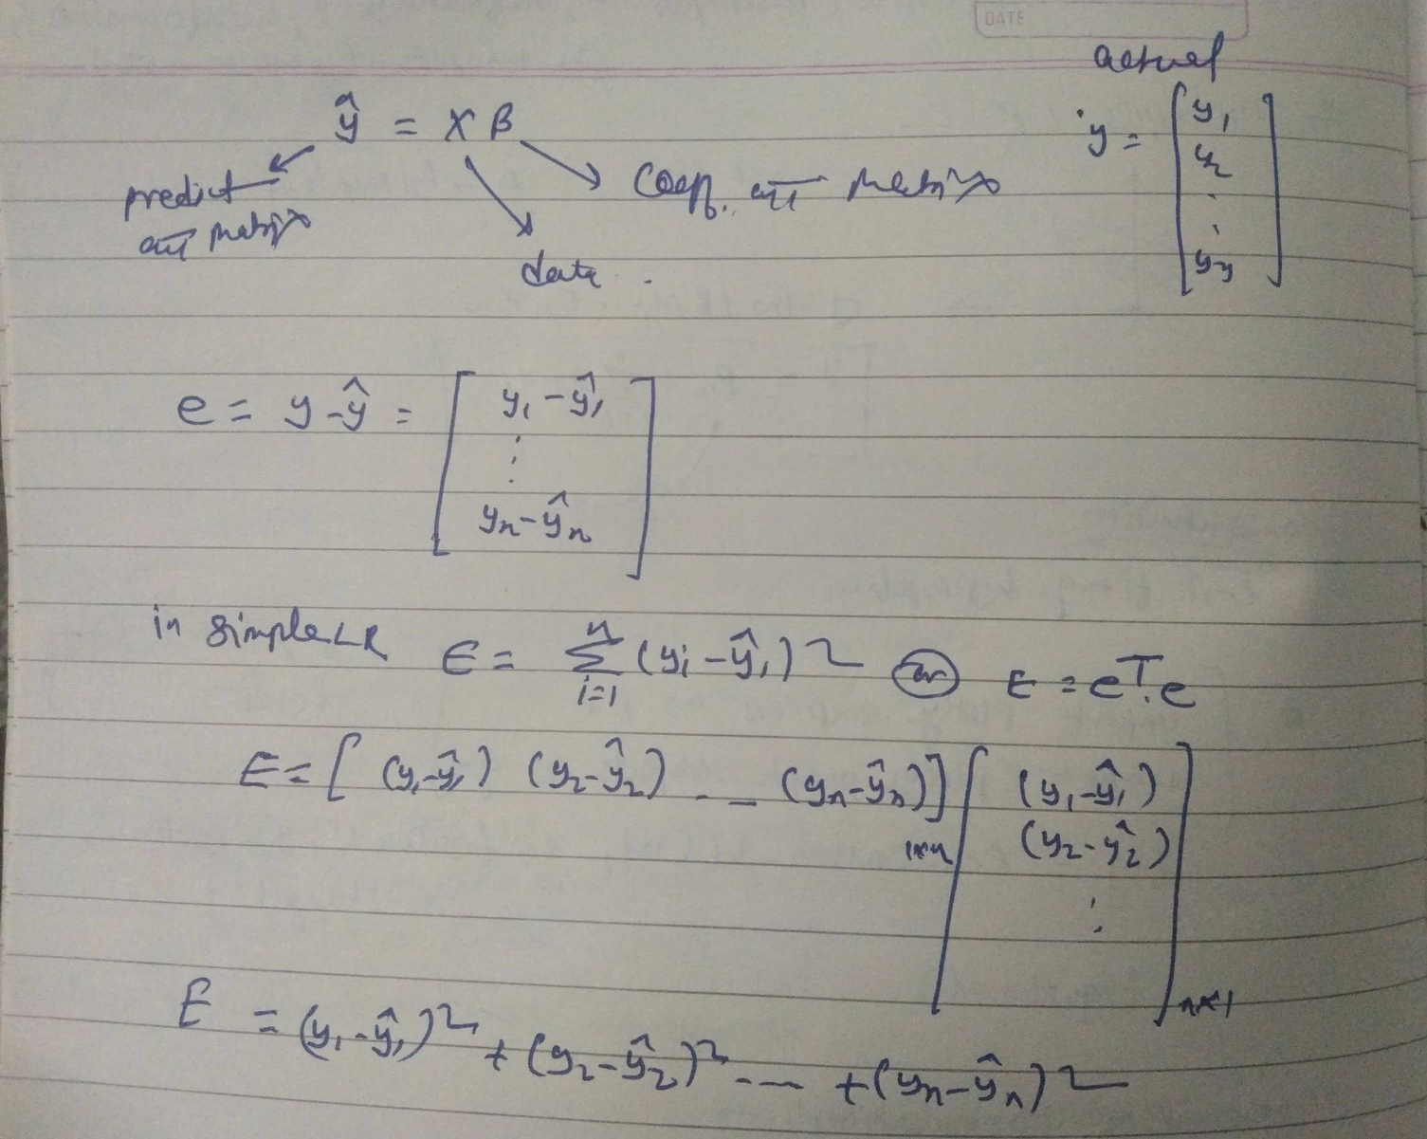
Multiple LR

Slide 19
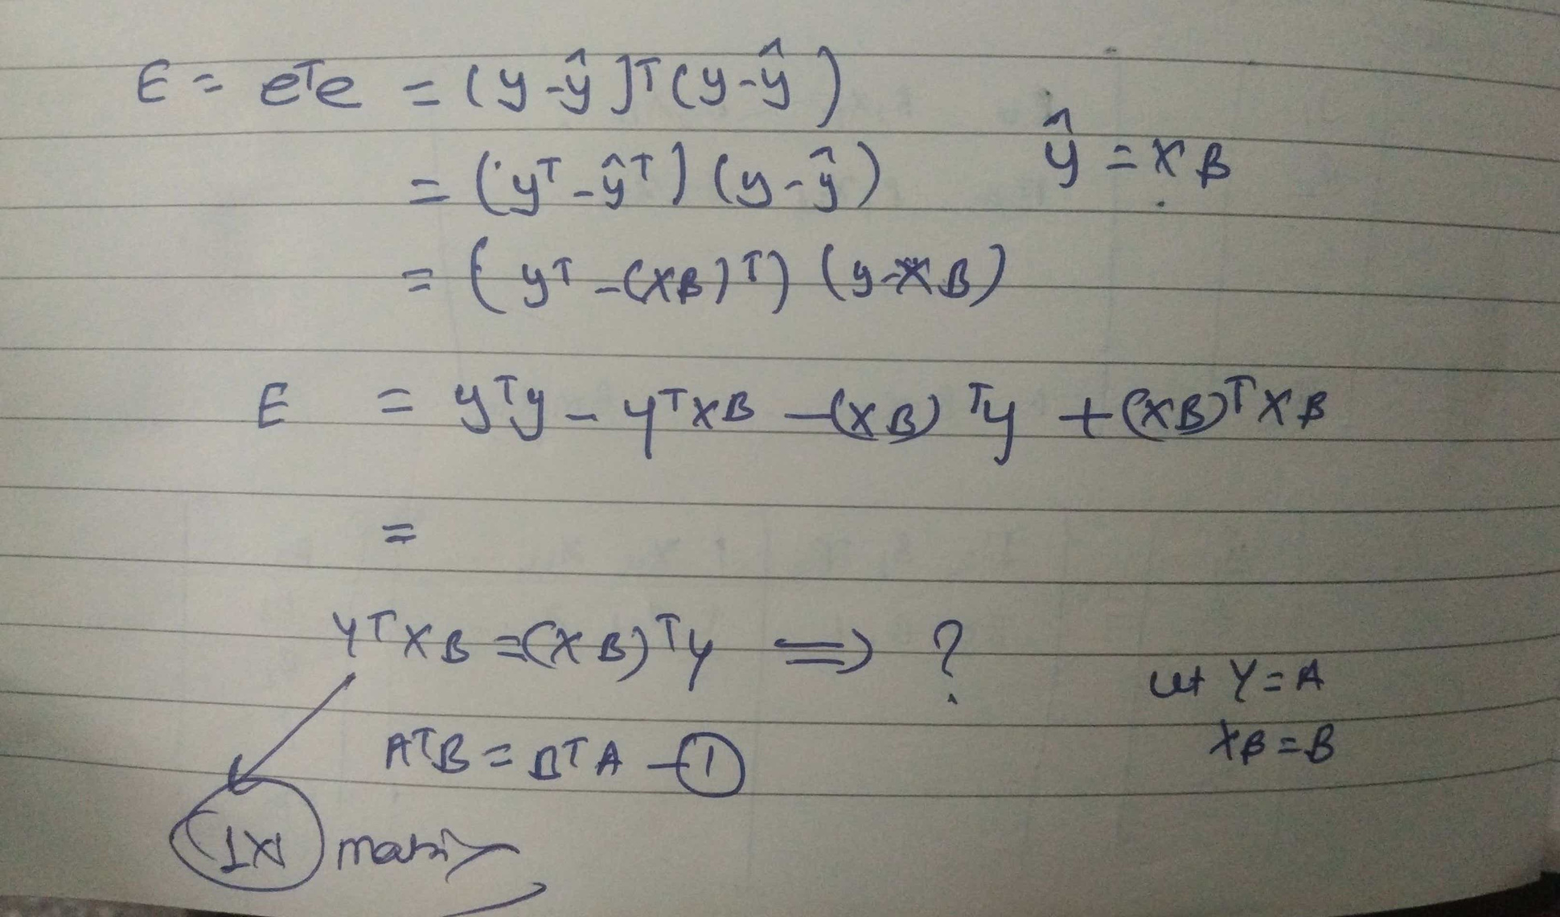
Multiple LR

Slide 20
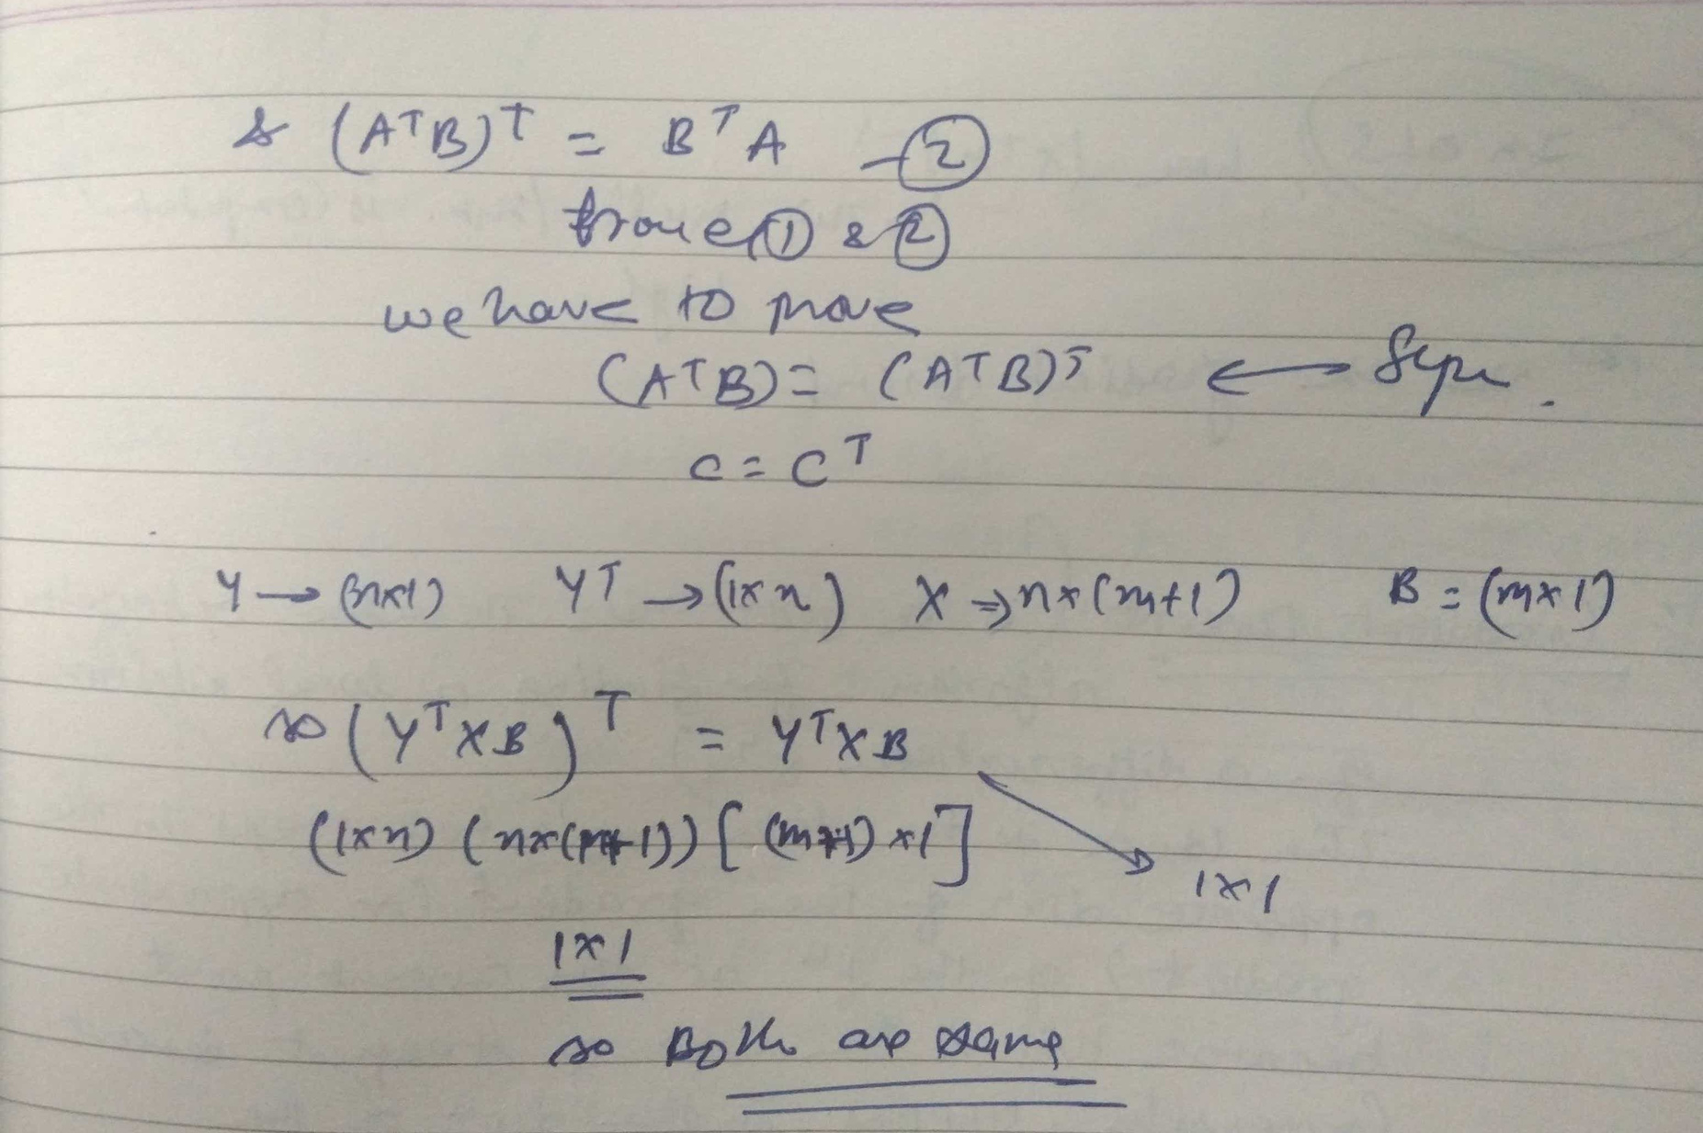
Multiple LR

Slide 21
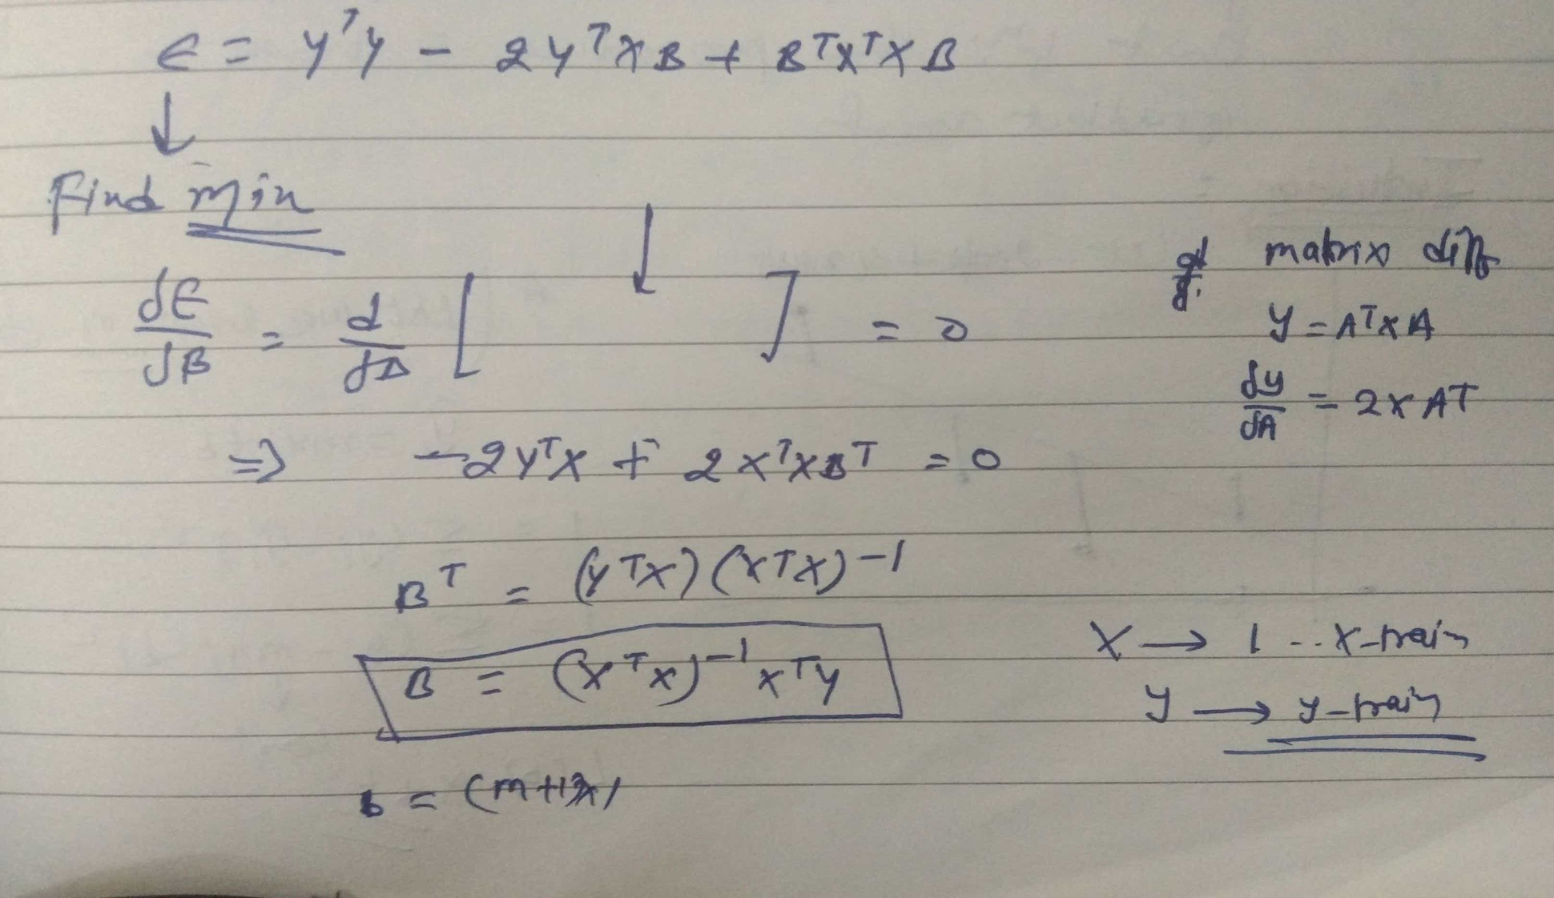
Multiple LR

Slide 22
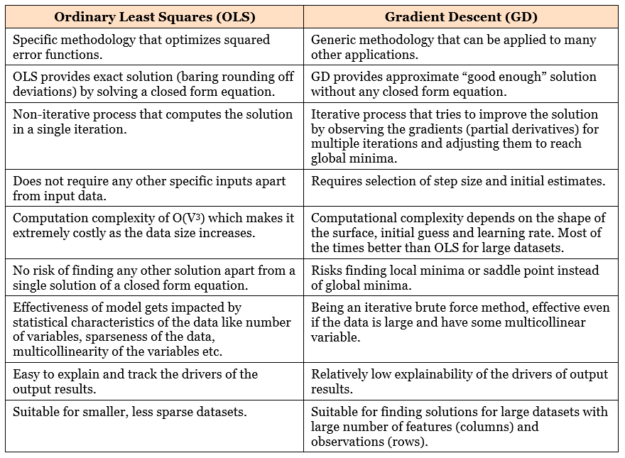

Slide 23
OLS
Linear regression using OLS is vulnerable to the problem of multicollinearity. As mentioned in the explanation of equation (1) above, linear regression coefficients represent the mean change in the dependent variable for each 1-unit change in an independent variable when you hold all of the other independent variables constant. Presence of multicollinearity compromises this definition as change in one variable effectively changes the other and hence impacts the dependent variable. This reduces the precision of coefficient estimates and in turn the effectiveness of the model

Slide 24

Gradient Descent
In mathematics, gradient descent (also often called steepest descent) is a first-order iterative optimization algorithm for finding a local minimum of a differentiable function. The idea is to take repeated steps in the opposite direction of the gradient (or approximate gradient) of the function at the current point, because this is the direction of steepest descent.
Conversely, stepping in the
direction of the gradient will
lead to a local maximum of that
function; the procedure is then
known as gradient ascent.

Slide 25
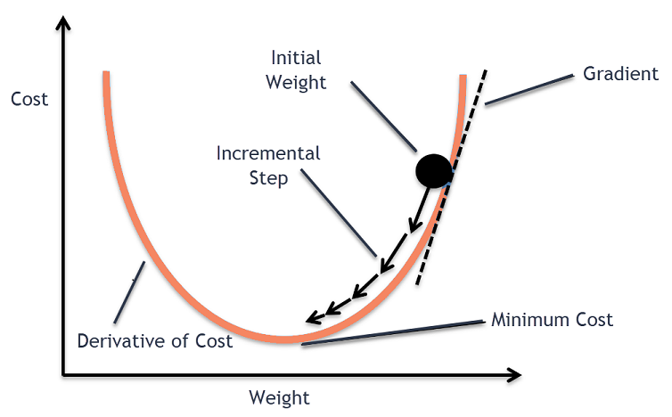
Gradient Descent
Using gradient descent, we try to achieve the “good enough” optimum solution instead of an exact solution. In most of the cases we don’t reach the exact global minima but obtain the pretty close approximation which is enough for large scale problems which are difficult to solve using closed form solutions.

Slide 26
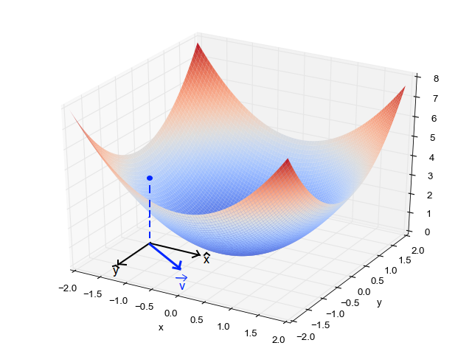
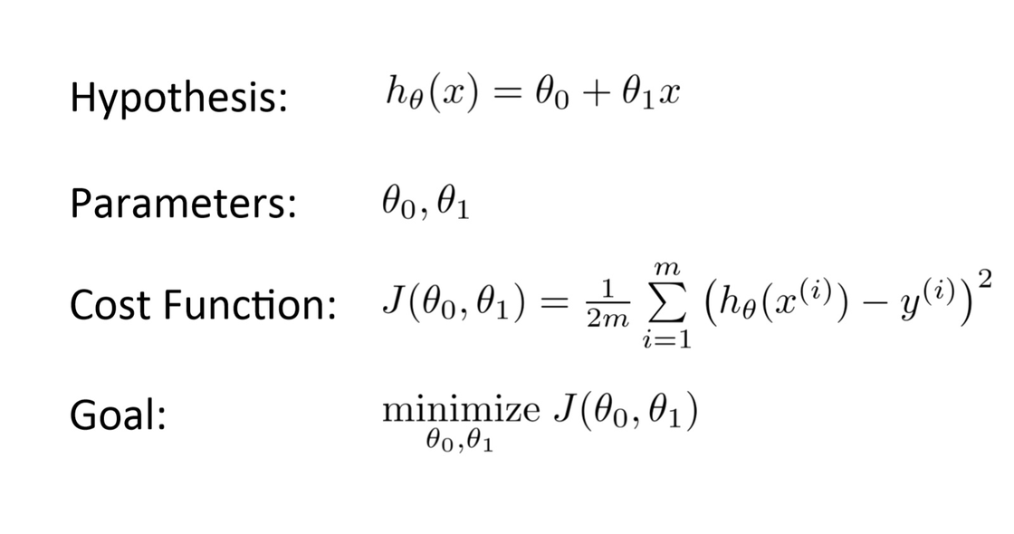
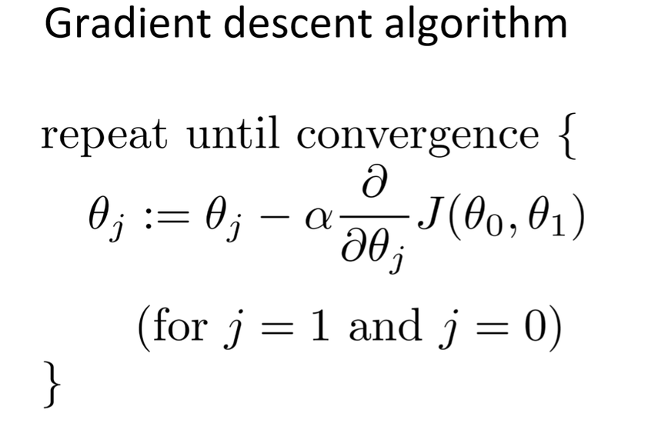
Gradient Descent

Slide 27
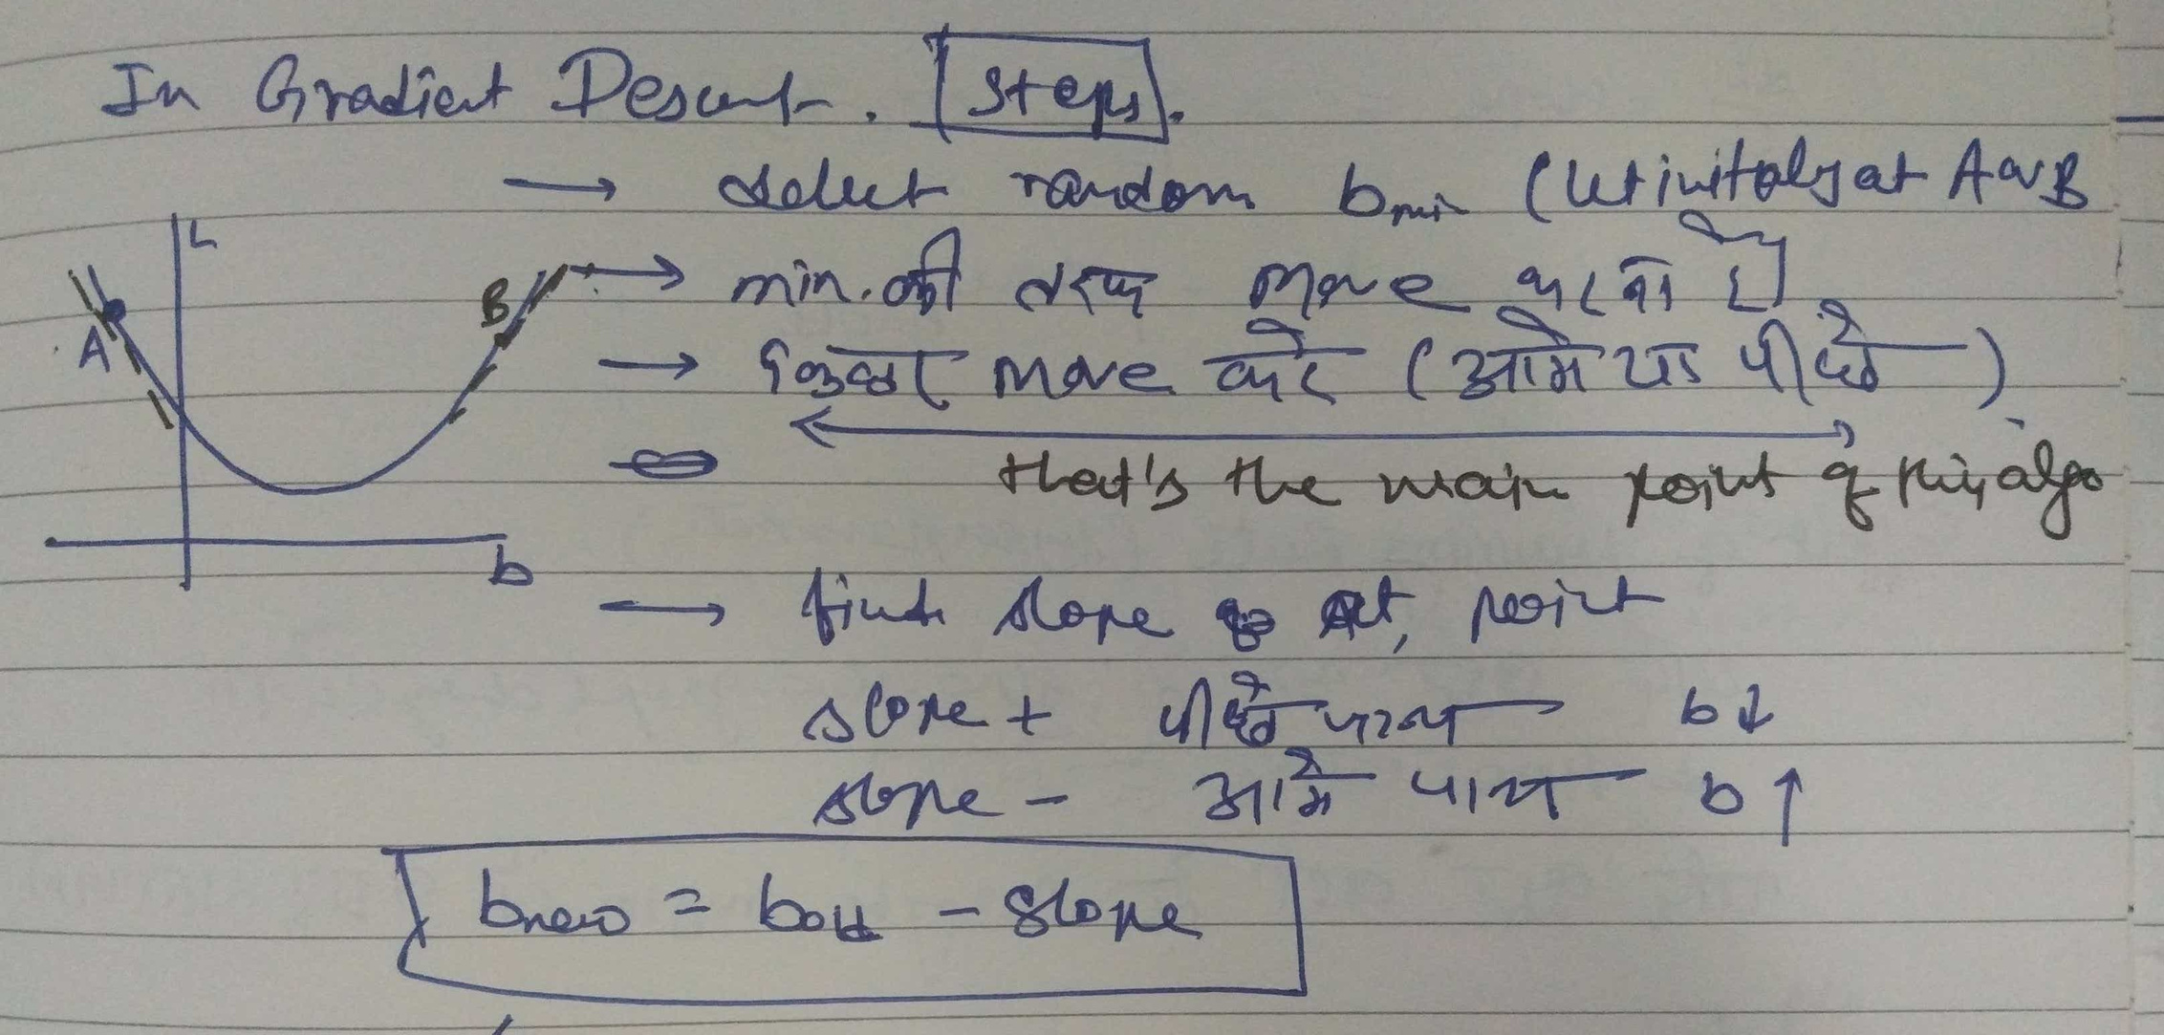
GD (Incremental Step)

Slide 28
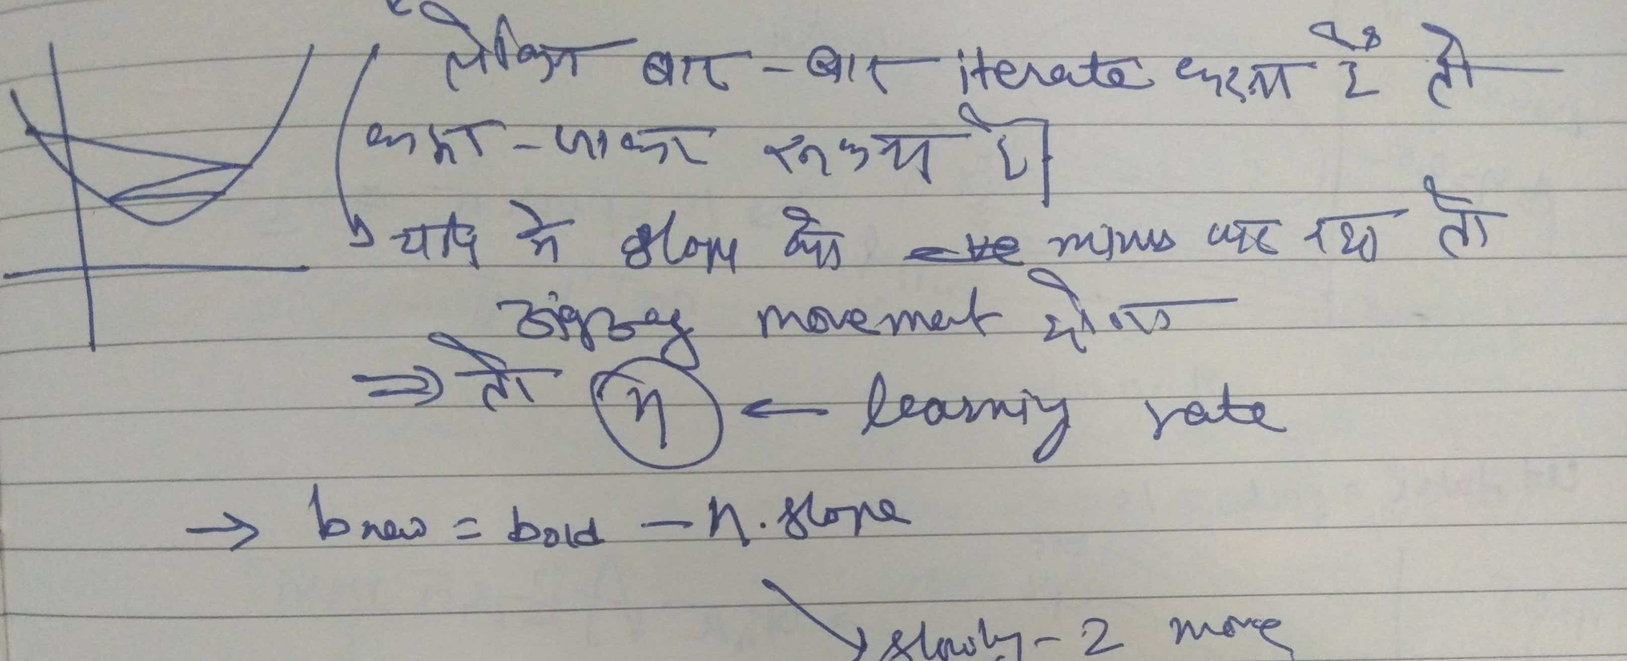
GD (Incremental Step)
https://developers.google.com/machine-learning/crash-course/fitter/graph

Slide 29
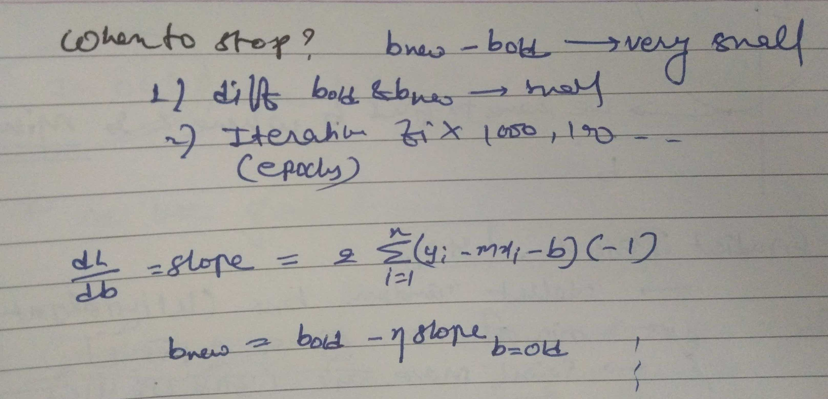
GD (Incremental Step)

Slide 30
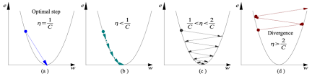

Learning Rate(Alpha)
We have the direction we want to move in, now we must decide the size of the step we must take.
It must be chosen carefully to end up with local minima.
If the learning rate is too high, we might OVERSHOOT the minima and keep bouncing, without reaching the minima
If the learning rate is too small, the training might turn out to be too long
a) Learning rate is optimal, model converges to the minimum
b) Learning rate is too small, it takes more time but converges to the minimum
c) Learning rate is higher than the optimal value, it overshoots but converges ( 1/C < η <2/C)
d) Learning rate is very large, it overshoots and diverges, moves away from the minima, performance decreases on learning

Slide 31
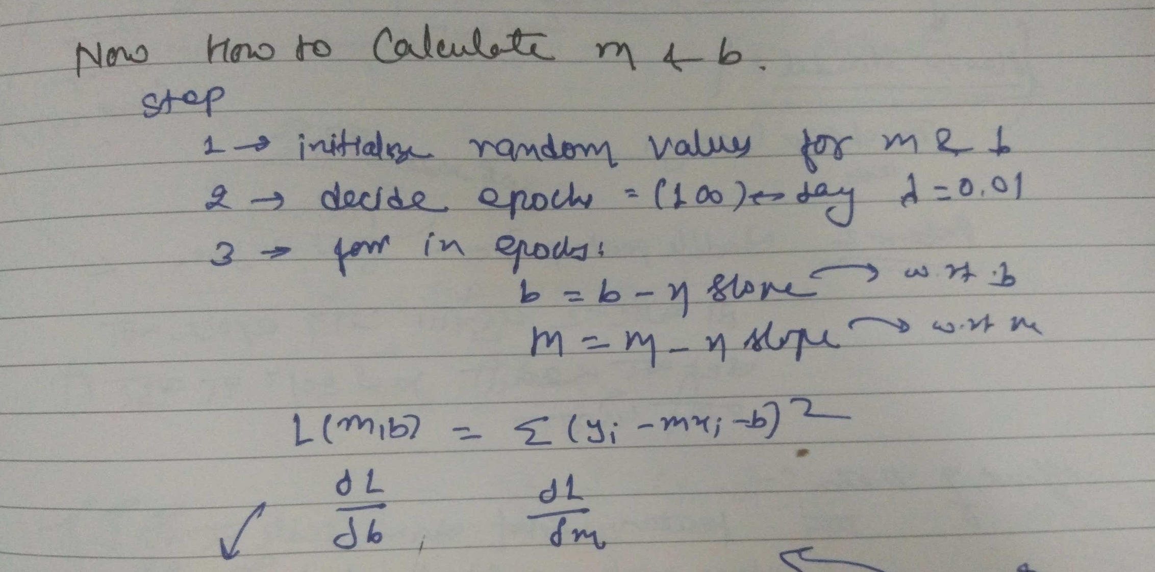
How to Calculate M & B

Slide 32
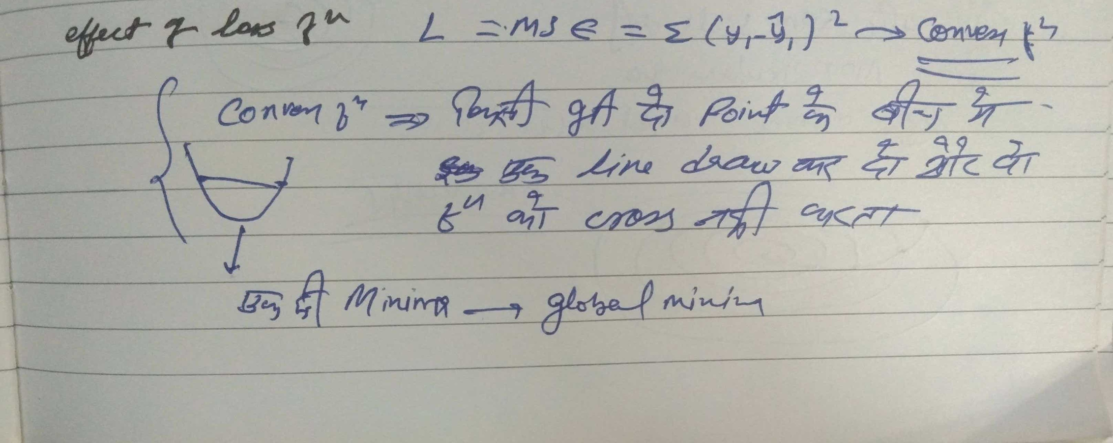
Effect of Loss Function

Slide 33
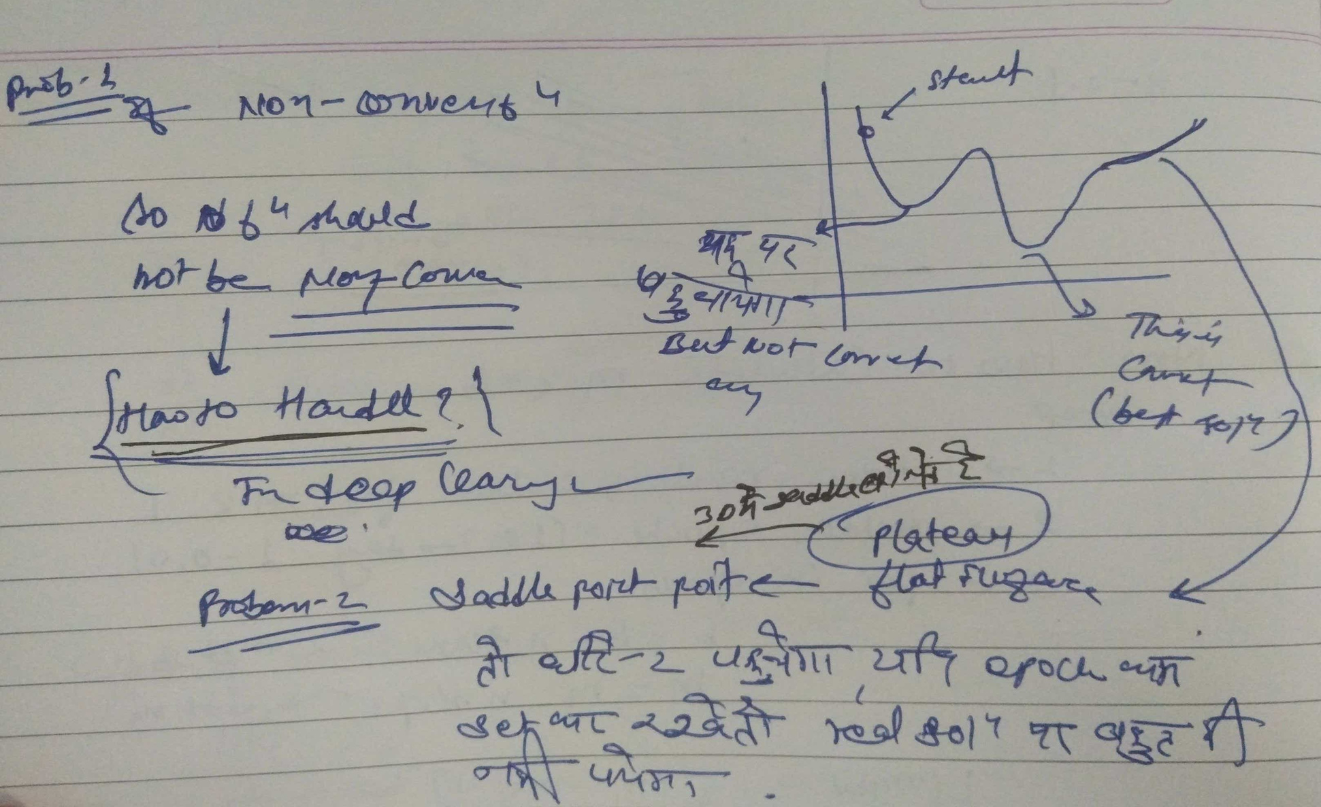
Problems with GD

Slide 34
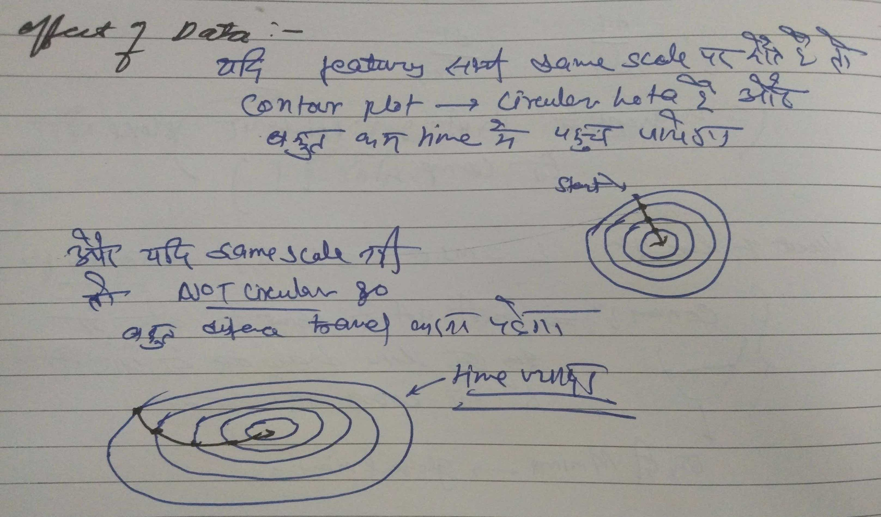
Effects of Data

Slide 35
Batch Gradient Descent
Let’s say there are a total of ‘m’ observations in a data set and we use all these observations to calculate the cost function J, then this is known as Batch Gradient Descent.
An epoch is when the entire training set is passed through the model, forward propagation and backward propagation are performed and the parameters are updated.

Slide 36
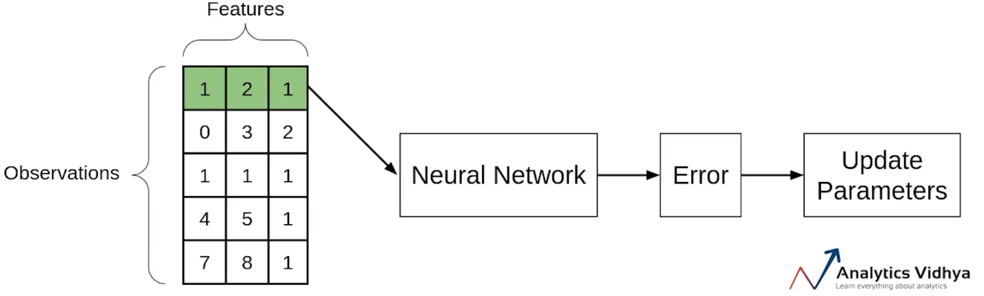
Stochastic Gradient Descent(SGD)
If you use a single observation to calculate the cost function it is known as Stochastic Gradient Descent, commonly abbreviated as SGD
If we use the SGD, will take the first observation, then pass it through the neural network, calculate the error and then update the parameters.

Slide 37
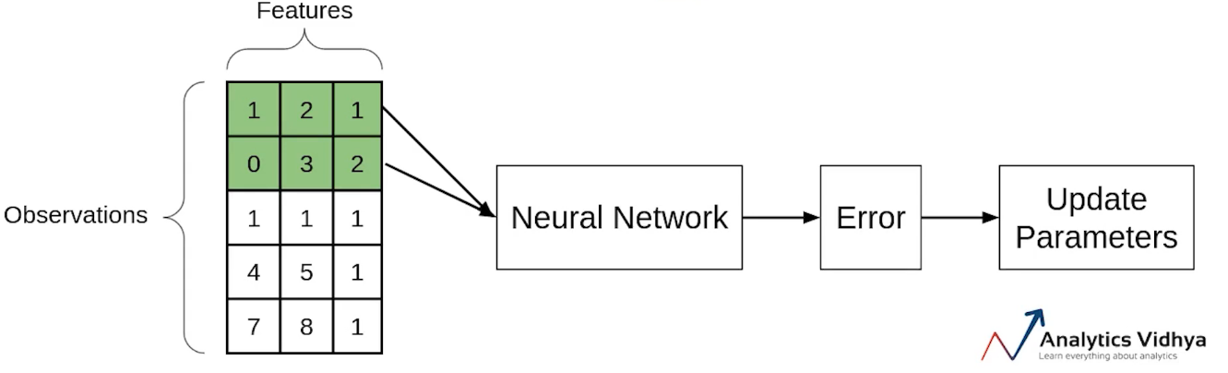
Mini-batch Gradient Descent
It takes a subset of the entire dataset to calculate the cost function.

Slide 38
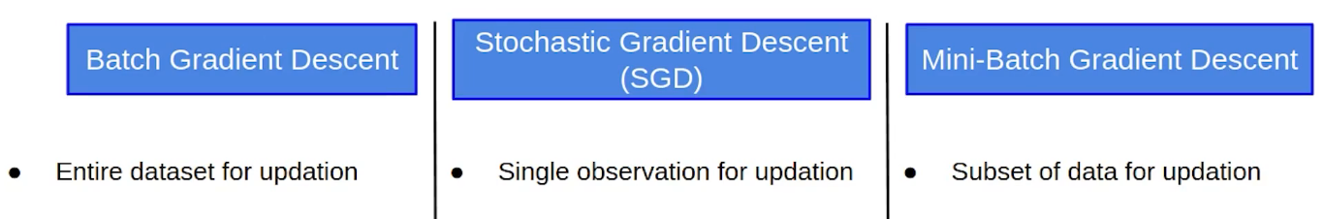
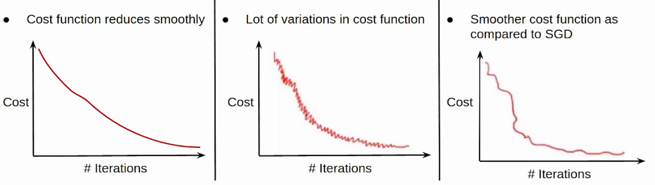
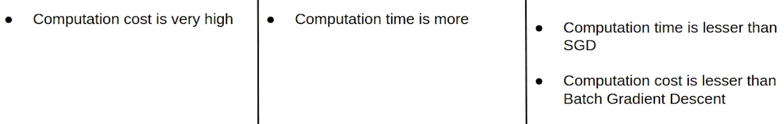
Comparison between Three
Due to randomness ...selection... may be next one will not better than previous

Slide 39
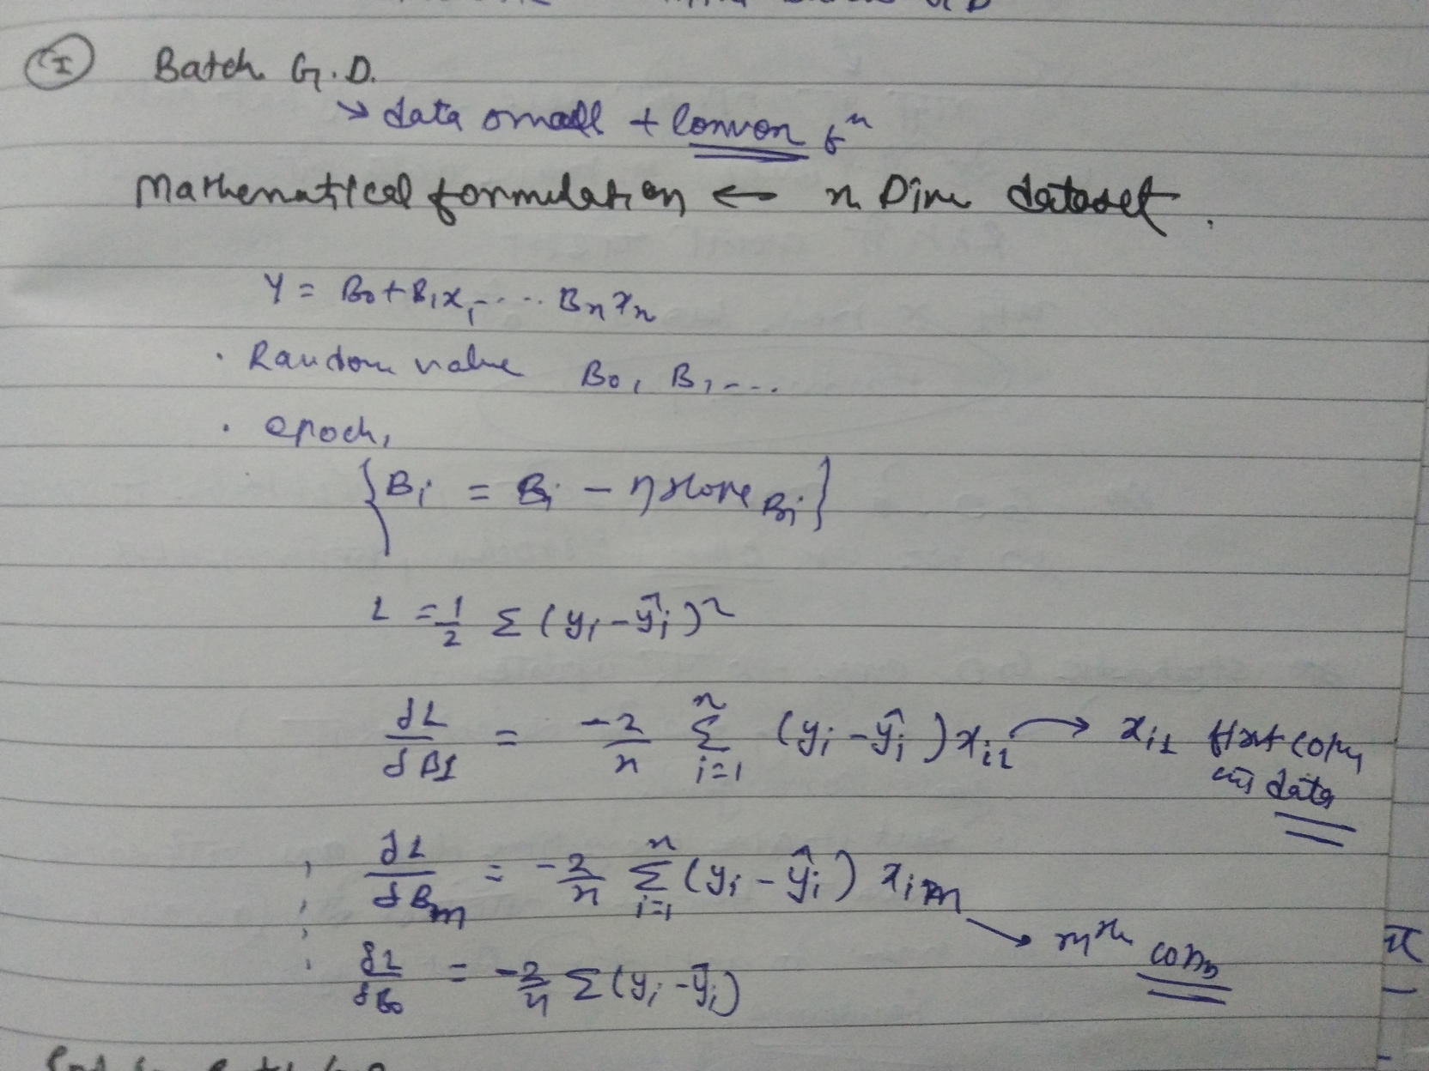
Batch GD (Calculation)

Slide 40
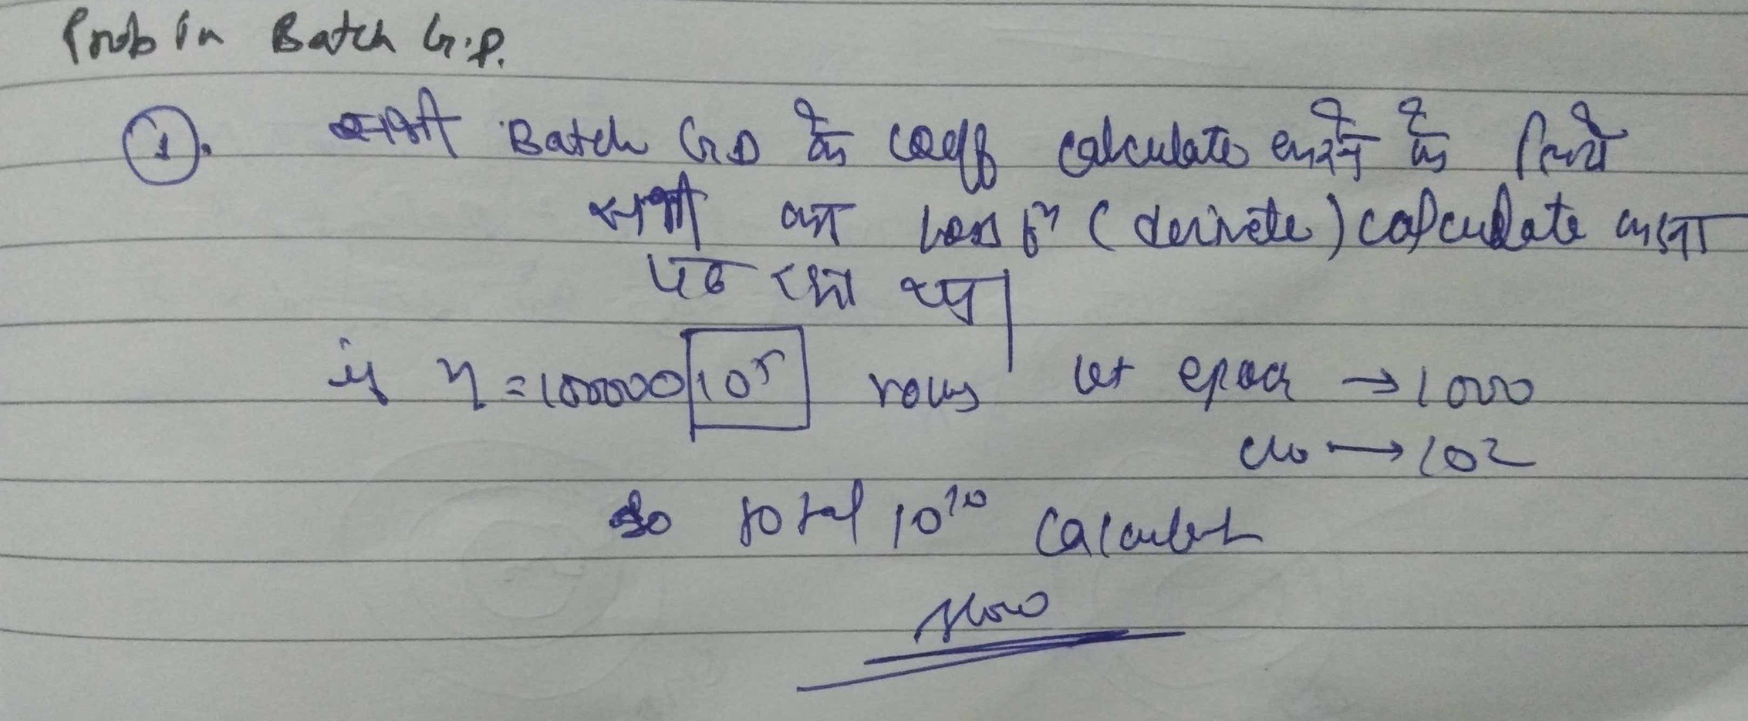
Problems in Batch GD

Slide 41
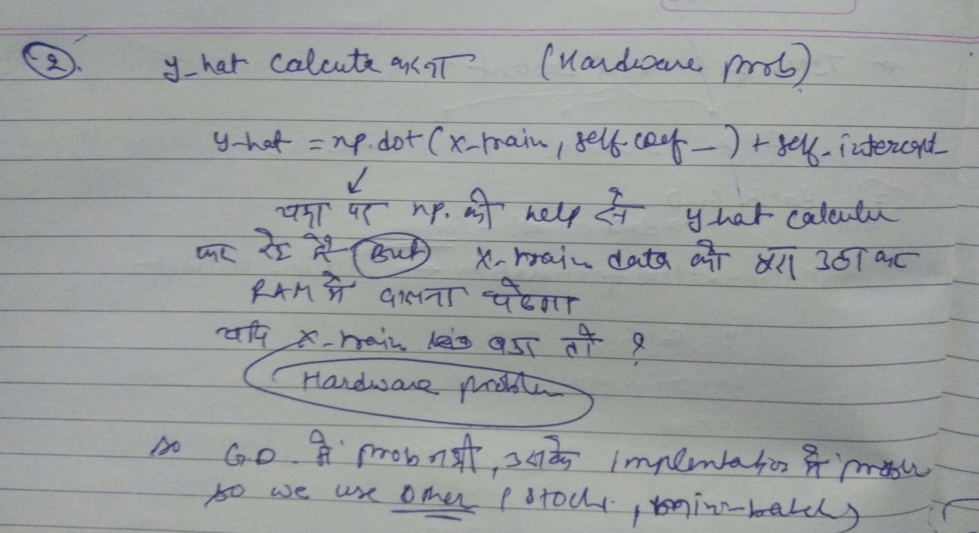
Problems in Batch GD

Slide 42
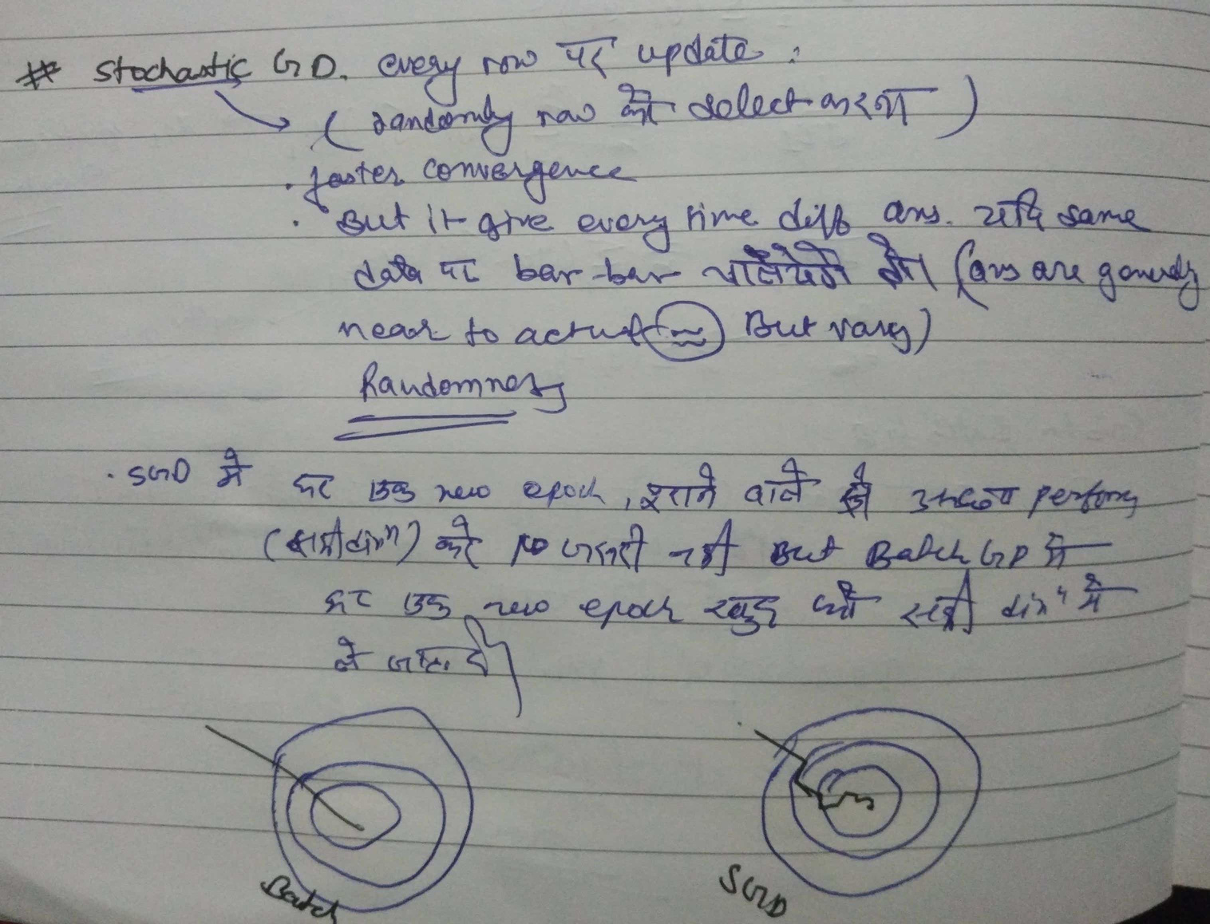
SGD

Slide 43
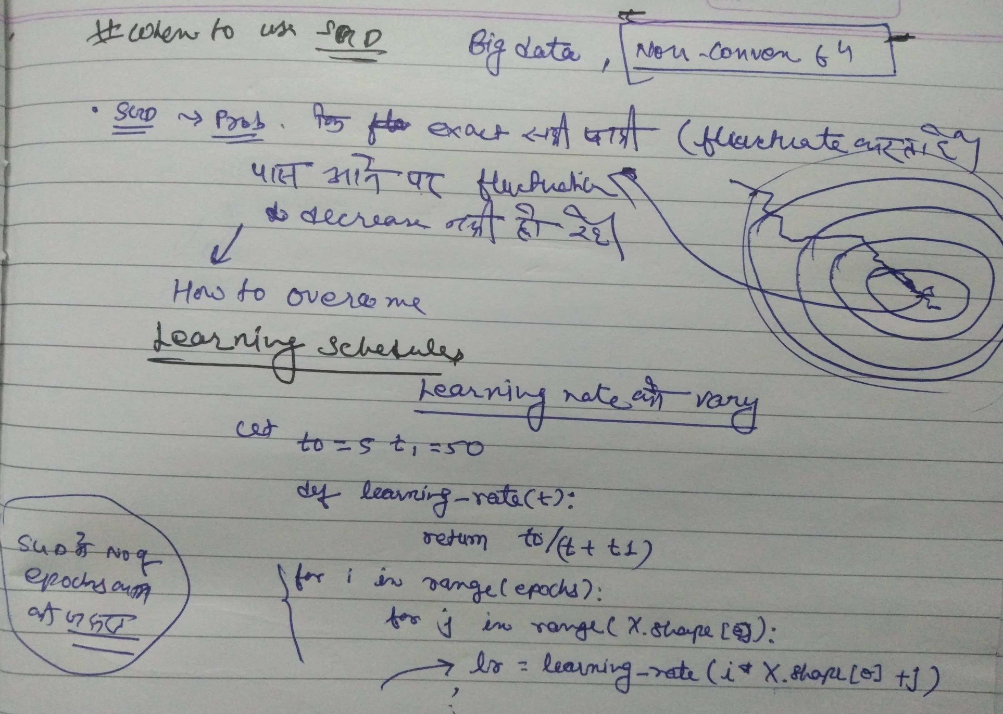
When to use SGD

Slide 44
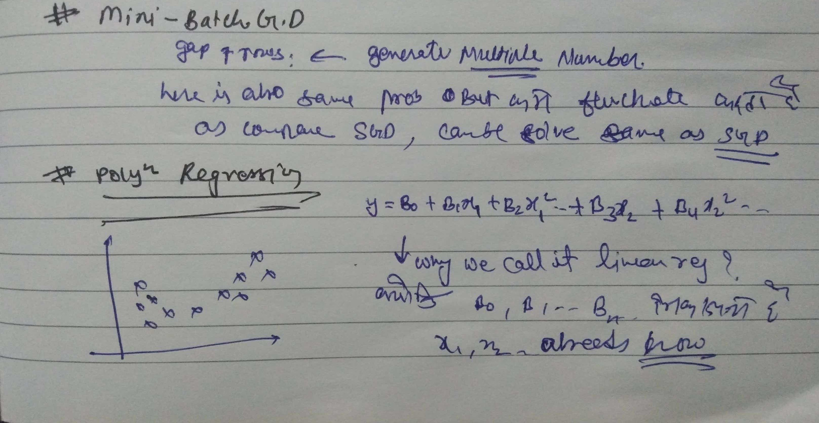
Mini-Batch GD & Polynomial Regression

Slide 45
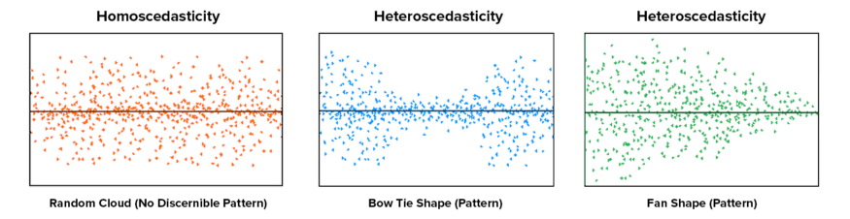
Assumptions of LR
Linear Relationship between the features and target
Little or no Multicollinearity between the features:
Homoscedasticity Assumption:
Normal distribution of error terms
Little or No autocorrelation in the residuals:
Homoscedasticity describes a situation in which the error term (that is, the “noise” or random disturbance in the relationship between the features and the target) is the same across all values of the independent variables.
A scatter plot of residual values vs predicted
values is a goodway to check for
homoscedasticity.There should be no clear
pattern in the distribution and if there is
a specific pattern, the data is heteroscedastic.

Slide 46
Assumptions of LR
normal distribution.However, a less widely known fact is that, as sample sizes increase, the normality assumption for the residuals is not needed. More precisely, if we consider repeated sampling from our population, for large sample sizes, the distribution (across repeated samples) of the ordinary least squares estimates of the regression coefficients follow a normal distribution. As a consequence, for moderate to large sample sizes, non-normality of residuals should not adversely affect the usual inferential procedures. This result is a consequence of an extremely important result in statistics, known as the central limit theorem.
Autocorrelation occurs when the residual errors are dependent on each other.The presence of correlation in error terms drastically reduces model’s accuracy.This usually occurs in time series models where the next instant is dependent on previous instant

Slide 47


Slide 48
Assumptions of LR
normal distribution.However, a less widely known fact is that, as sample sizes increase, the normality assumption for the residuals is not needed. More precisely, if we consider repeated sampling from our population, for large sample sizes, the distribution (across repeated samples) of the ordinary least squares estimates of the regression coefficients follow a normal distribution. As a consequence, for moderate to large sample sizes, non-normality of residuals should not adversely affect the usual inferential procedures. This result is a consequence of an extremely important result in statistics, known as the central limit theorem.
Autocorrelation occurs when the residual errors are dependent on each other.The presence of correlation in error terms drastically reduces model’s accuracy.This usually occurs in time series models where the next instant is dependent on previous instant

